Slide 1






SP COURSE
PROJECT
Presented by Eliminators

Slide 2
OUR TEAM
Snehil
Roshan
Gautam

Slide 3
PART-1
BIRD RECOGNITION

Slide 4
INTRODUCTION
  Bird sounds are unique acoustic signatures that can help identify bird species.
  These sounds have specific time and frequency characteristics that can be analyzed.

Slide 5
GOAL
  Analyze the sounds of three distinct bird species to identify distinguishing features.
  Use these features to identify the specie of the given bird sounds.

Slide 6
APPROACH AND METHODOLOGY
  We plotted waveforms of the three bird species to understand their time-domain patterns, and computed and analyzed the FFT magnitude and phase plots to observe frequency-domain characteristics.
  We observed that bird sounds of the same species have similar FFT magnitude plots. This consistency in frequency characteristics provides a unique signature for each bird species.
  Task bird sounds are compared with the reference bird sounds based on their FFT magnitude plots. This approach proved sufficient for distinguishing the bird species.

Slide 7
TIME-DOMAIN ANALYSIS
  We plot the waveforms of similar sounding bird files to visualize the time-domain patterns.
  We observe these plots to have similar shapes, but we will need a much complex algorithm to compare them in time domain to compute the bird species.

Slide 8
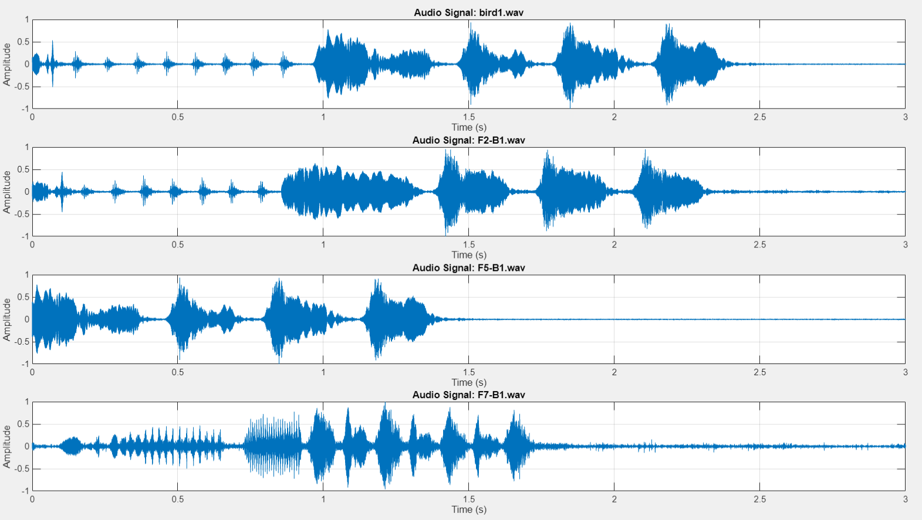
TIME-DOMAIN ANALYSIS

Slide 9
FREQUENCY-DOMAIN ANALYSIS
  We computed the FFTs of similar sounding bird files and plotted their magnitudes to visualize the frequency-domain patterns.
  We observe these plots to be very much similar, and thus we use this frequency domain analysis to compute the bird species.

Slide 10
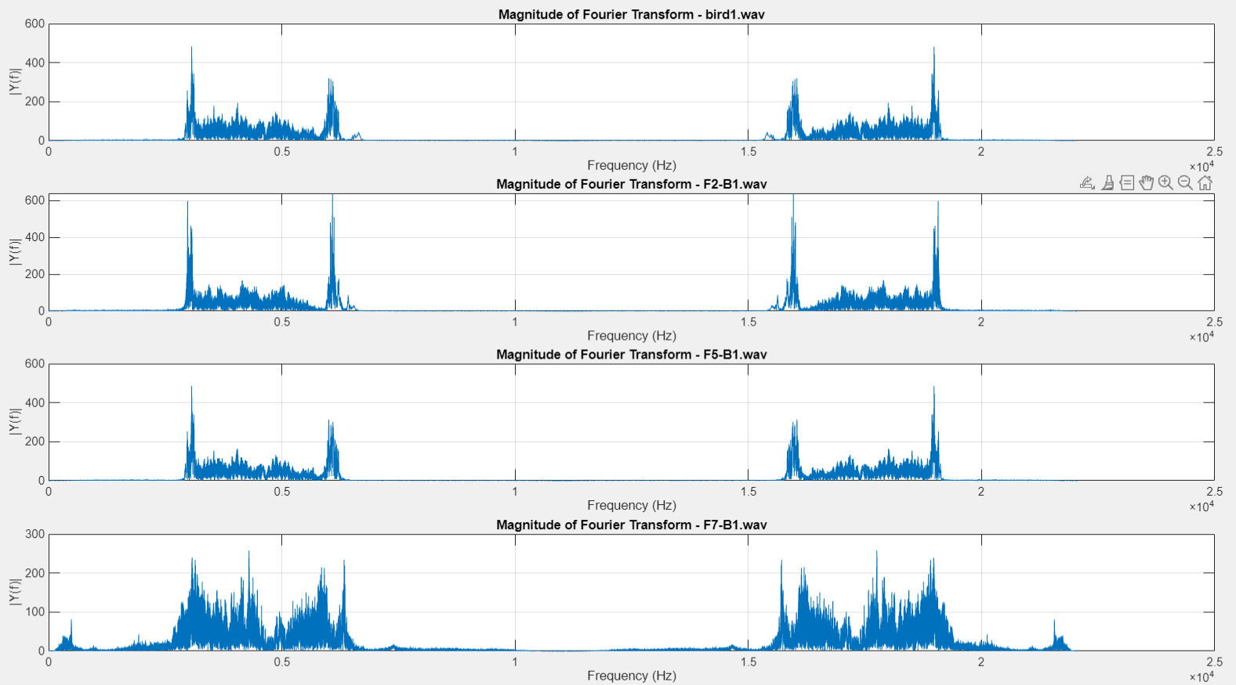
FREQUENCY-DOMAIN ANALYSIS
FFT magnitudes of birds sounding similar to bird-1

Slide 11
IMPLEMENTATION OVERVIEW
  Reference Data: FFT magnitude data of the three distinct bird species was precomputed and stored for comparison.
  Testing Process:
    A new bird sound is selected for testing.
    The audio file is analyzed to extract its FFT magnitude.
  Comparison Logic:
    For each bird species, the sum of absolute differences between the test FFT magnitude and the reference FFT magnitude is computed.
    These differences are calculated only within the selected frequency ranges to improve accuracy.
  Frequency Ranges:
    Specific frequency ranges are selected for comparison based on observed patterns in the reference data.
    These ranges correspond to key frequency bands that are distinct for each bird species.
  Classification:
    The bird species corresponding to the minimum difference is identified as the most similar species.

Slide 12
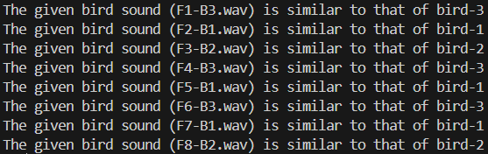
RESULTS
Task File | Identified Species
F1 | 3
F2 | 1
F3 | 2
F4 | 3
F5 | 1
F6 | 3
F7 | 1
F8 | 2
  Accuracy:
    Correctly identified bird species using FFT magnitude analysis.
    The selected frequency ranges ensured reliable classification.
  Strengths:
    Simple and efficient method for species recognition.
    Leverages distinct frequency characteristics to differentiate species.
  Challenges:
    Assumes all bird sounds have clear frequency characteristics.
    Noise in the test audio might affect accuracy.

Slide 13
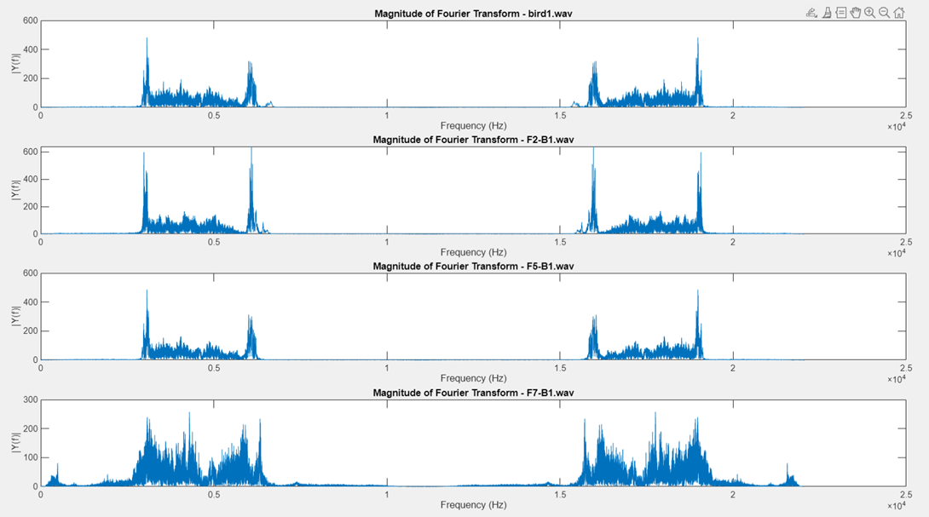
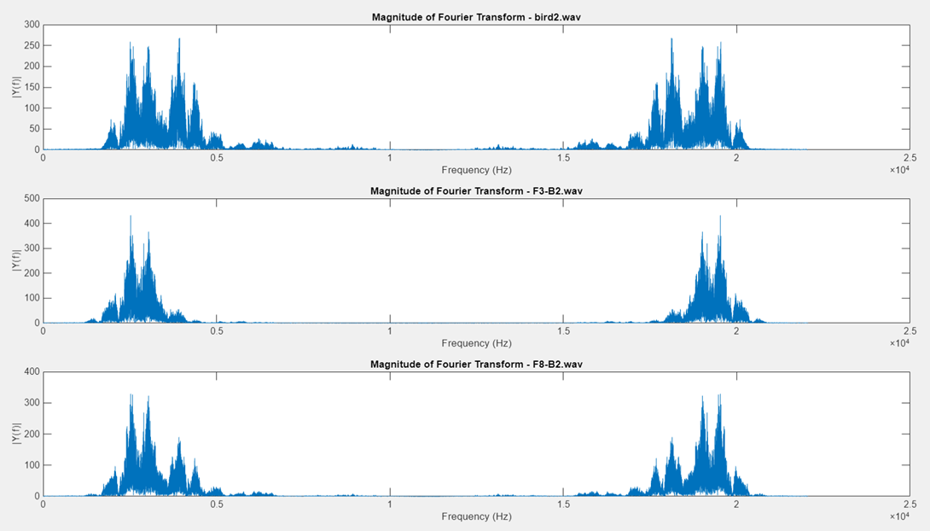
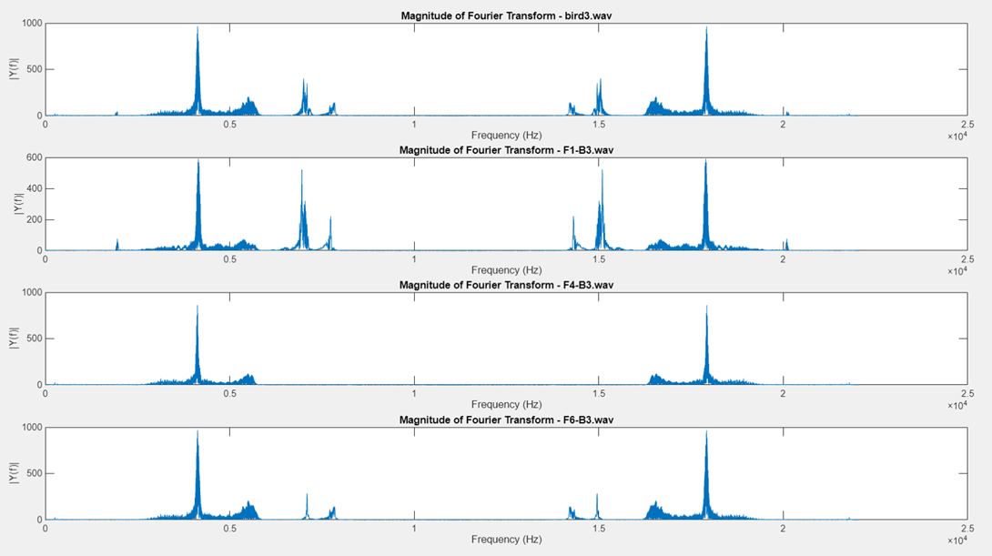
PLOTS

Slide 14
PART-2
HEART RATE ESTIMATION

Slide 15
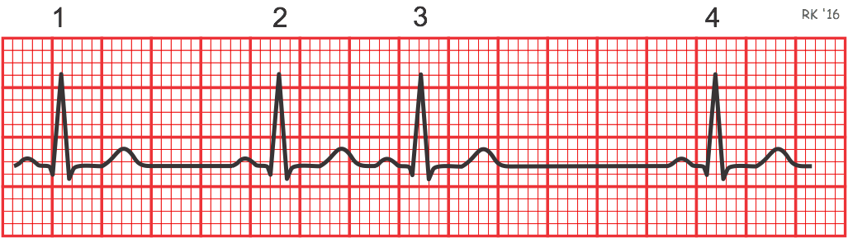
INTRODUCTION
This is a ECG
  Heart rate is measured between two consecutive R peaks
  HR(t)=60/r-r intervals
  Task 1 – Finding and Plotting the HR for E1 (Noise-Free ECG Signal)
  Task 2 – Noise Removal and repeating for E2 and E3 (Noisy ECG Signals):

Slide 16
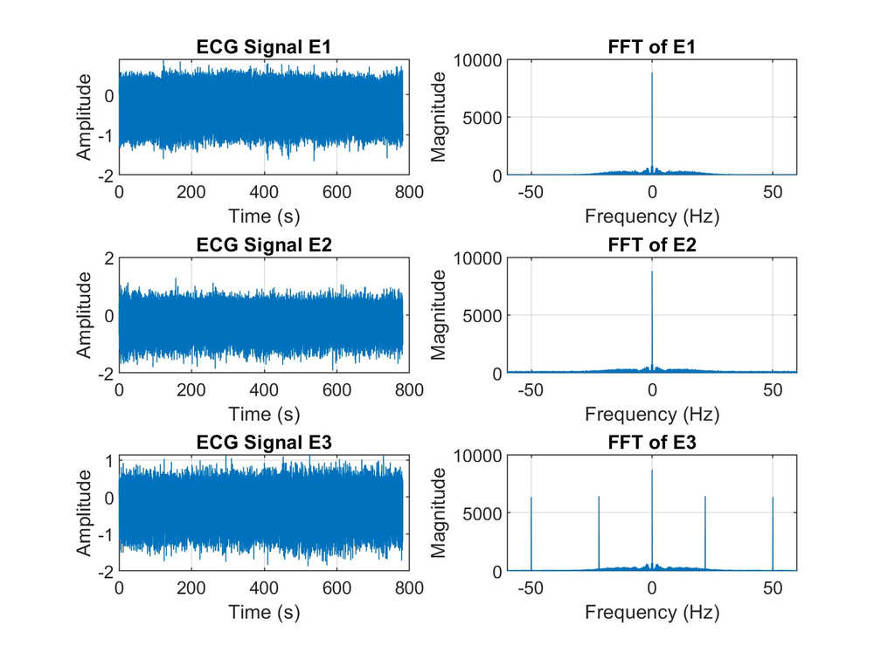
PROBLEM
NOISE
  Given, E1 is ideal signal,Since E2 and E3 has frequency components whcih are unnecessary, we remove them by using LPF and bandstop filter(for E3)

Slide 17
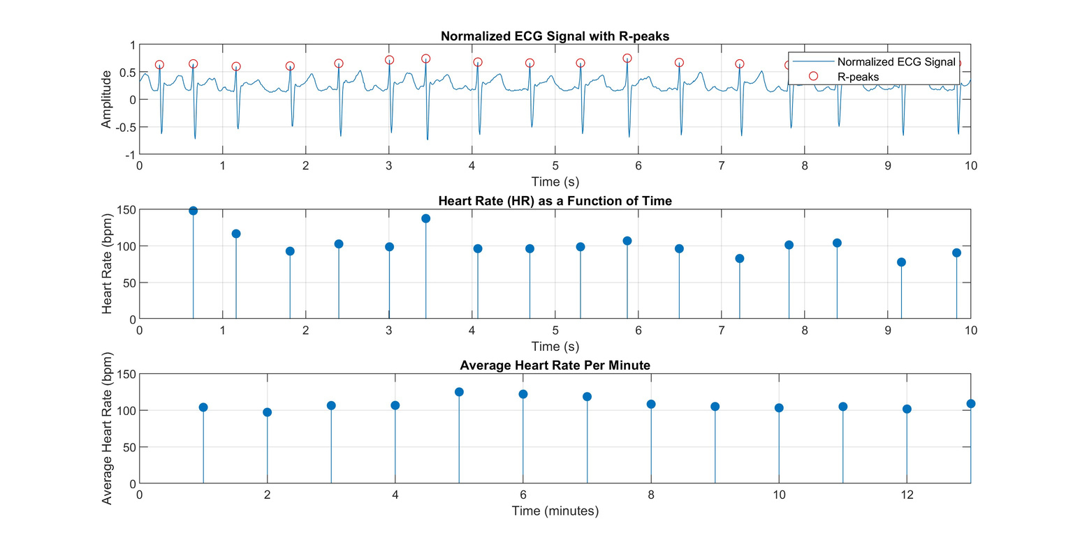
ESTIMATING HEART RATE FORM E1
  Since the signal is ideal, we use findpeak function and trace out all R peaks.
  We calculate the time between each peak.
  HR=60/T
  the second plot is heart rate every second and the third plot is per minute

Slide 18
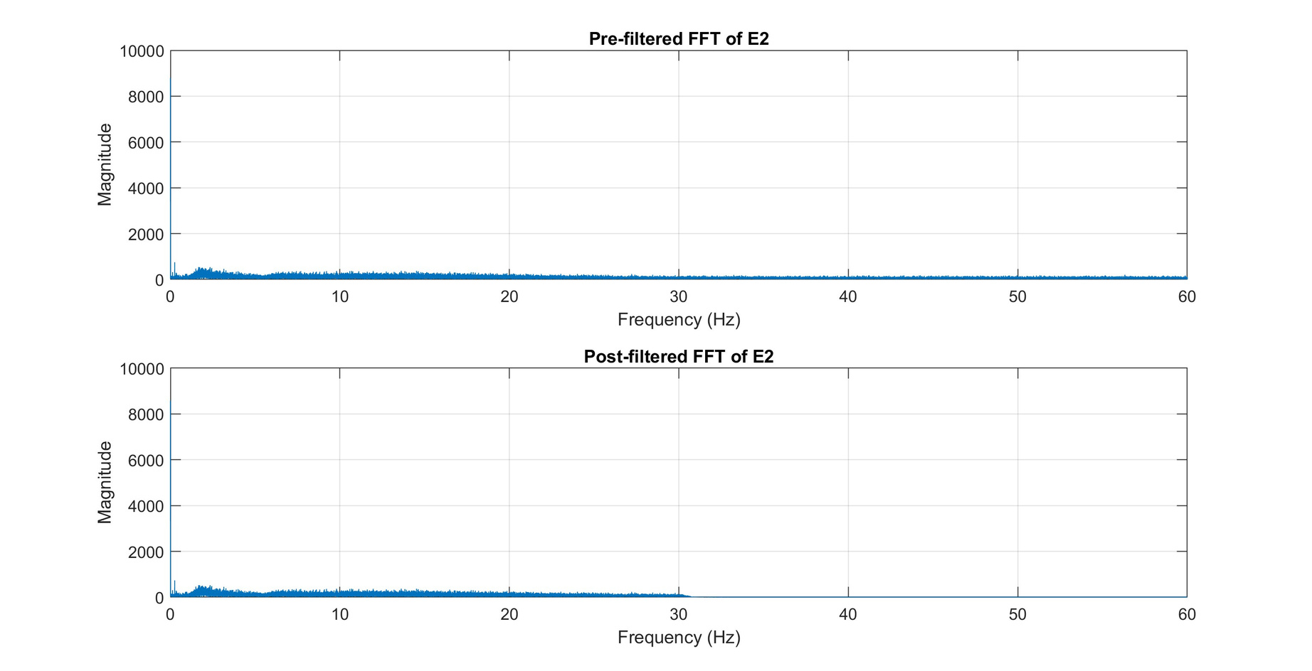
E-2 PRE AND POST NOISE FFT
>30 Hz are removed to match with E1.

Slide 19
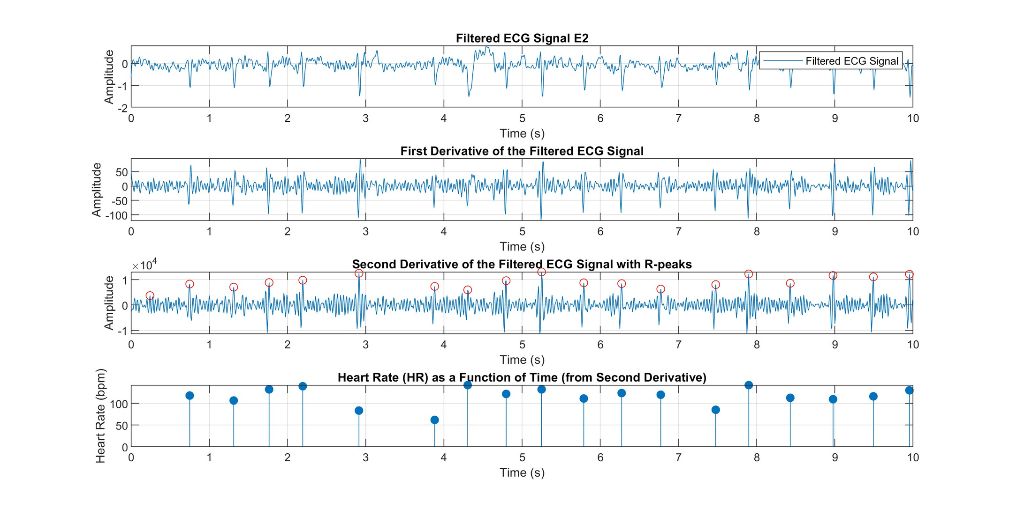

Slide 20
EXPLANATION E2
  The noise is still threre in filtered signal and we cannot use findpeak fn as it will detect nosiy peaks
  Inorder to solve this, we differentiate the signal twice and then use findpeak function on the second differential.
WHY 2ND DIFFERENTIAL
  The second derivative detects the rate of change of the slope. It is particularly sensitive to the points where the signal undergoes rapid changes, such as at the peak of the R-wave. At the R-peak, the ECG waveform typically transitions from a steep rise to a rapid fall

Slide 21
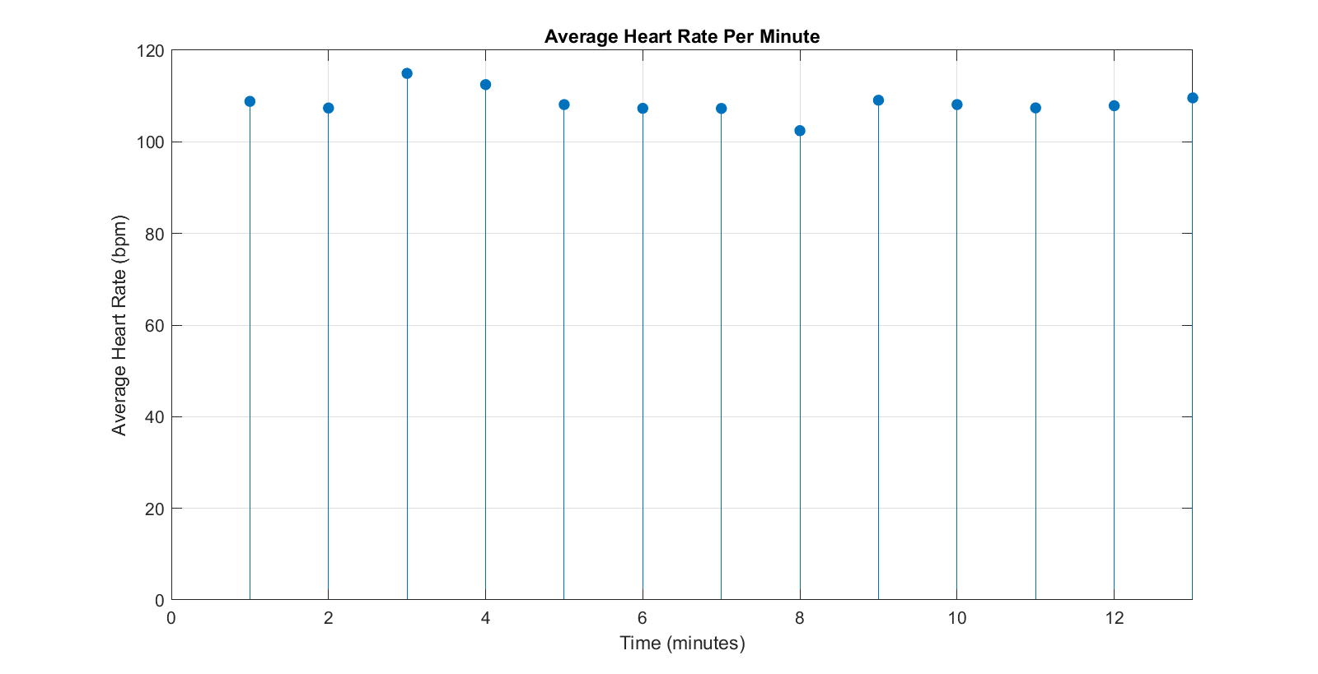
E2 HEART RATE PER MIN

Slide 22
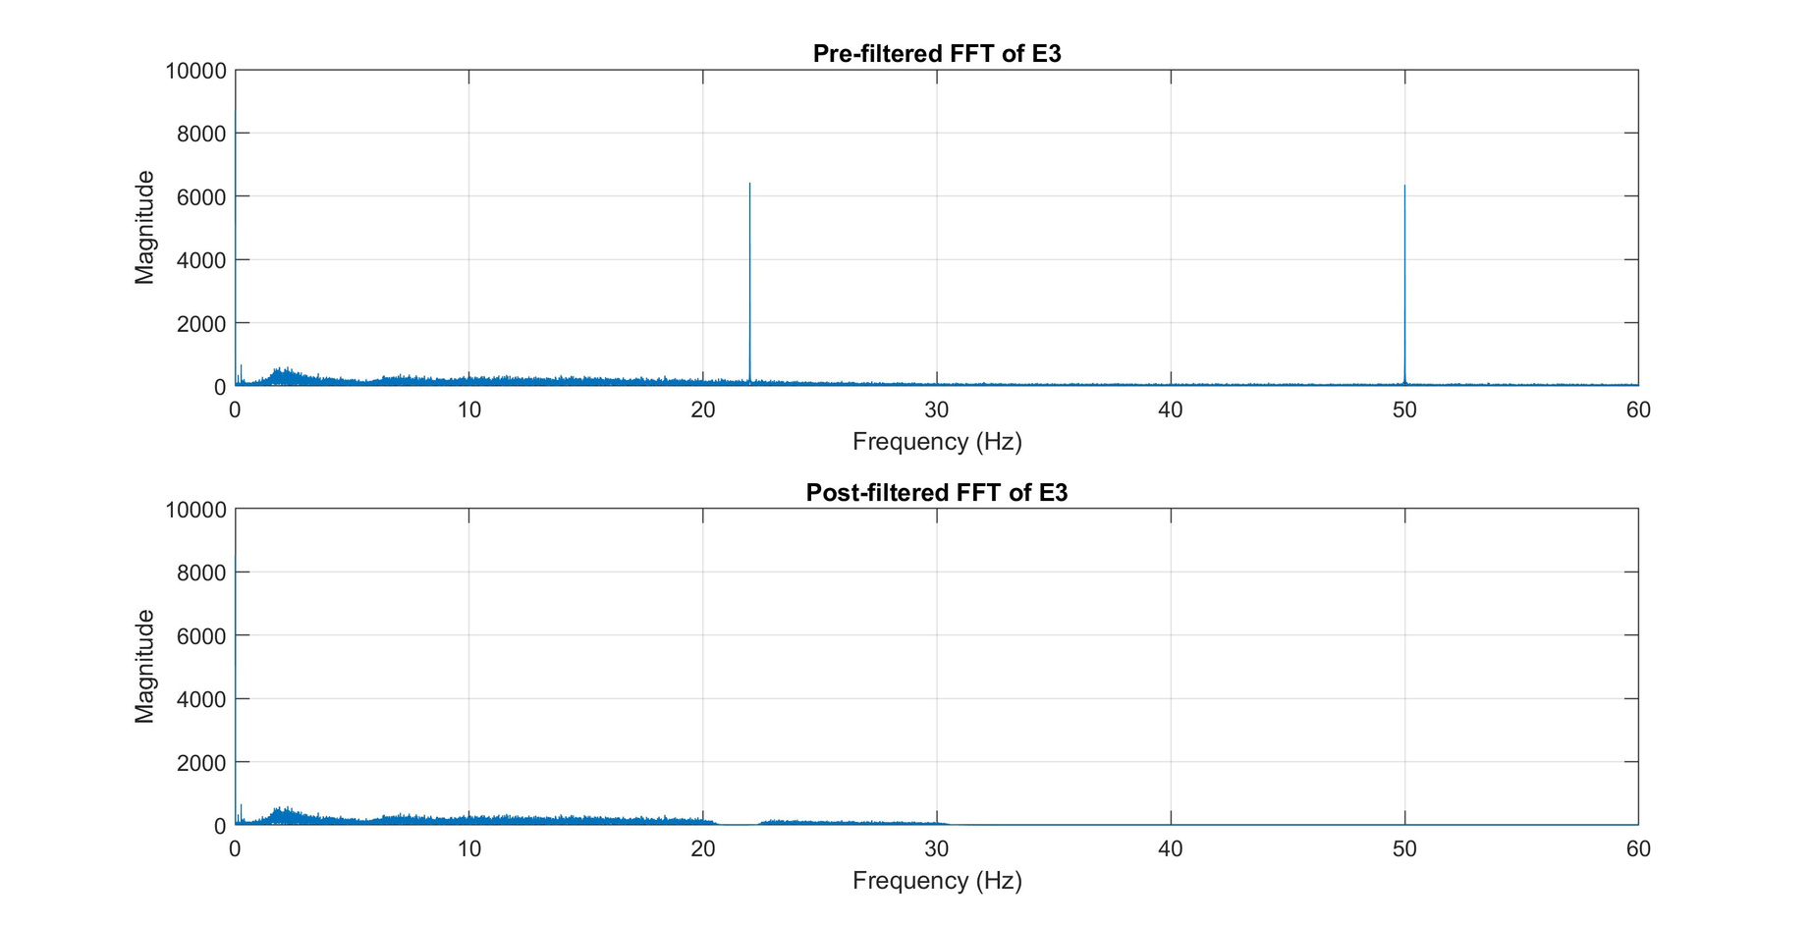
E3 NOISE
Using bandstop and lpf

Slide 23
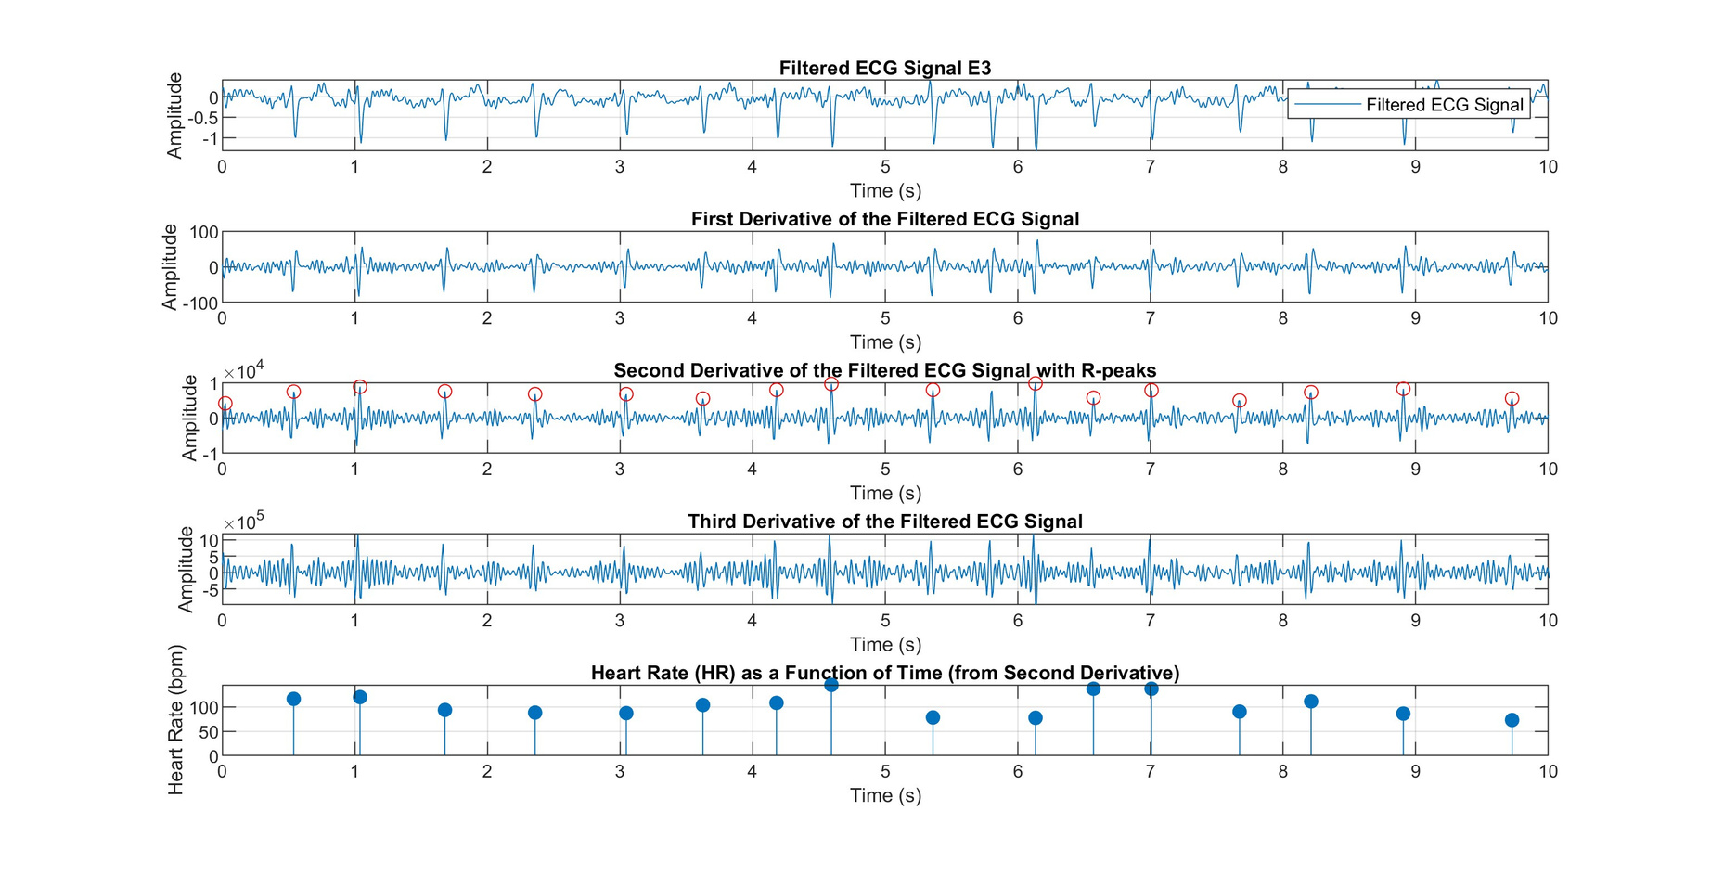
E3 ANALYSIS
  the same goes here, we cant use findpeak fn directly
  we use it in second derivative

Slide 24
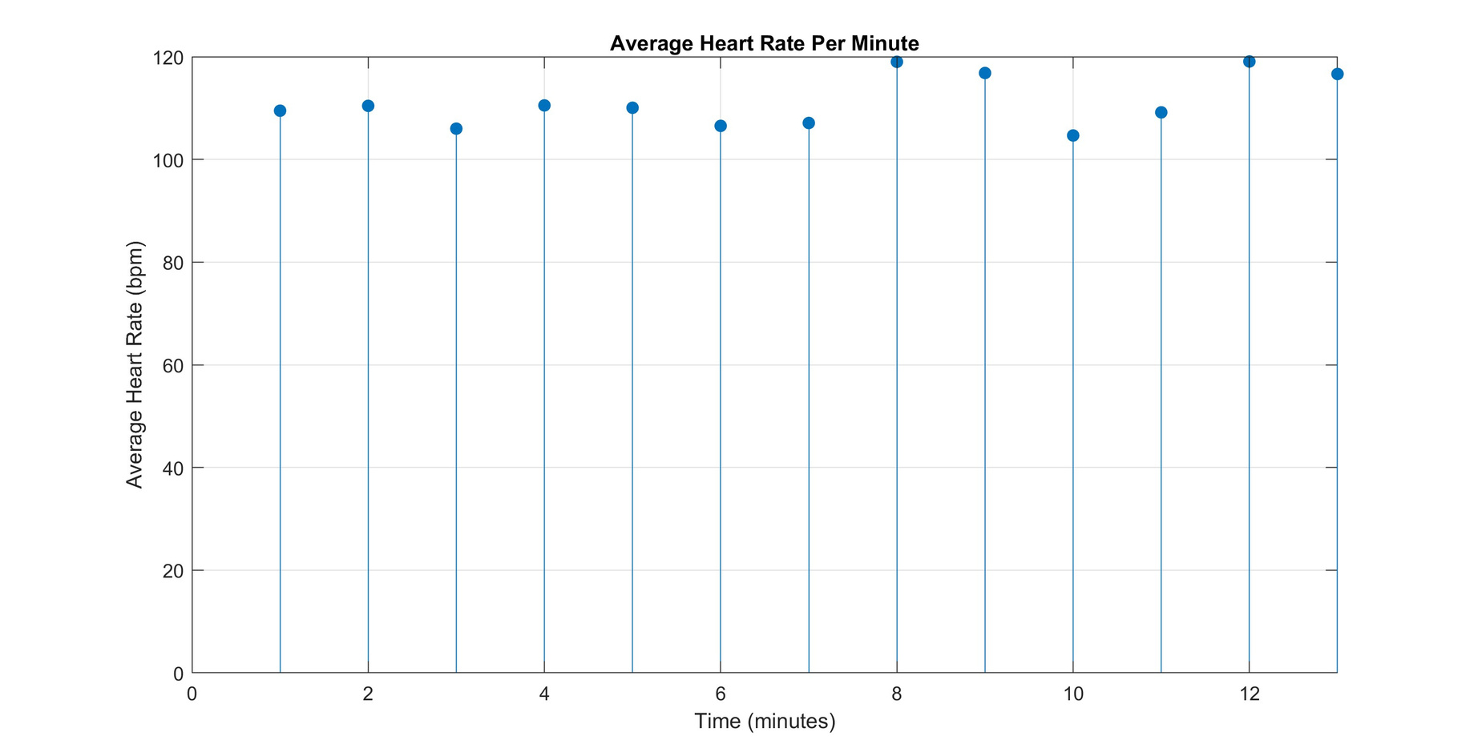
E3 HEART RATE

Slide 25
PART-3
LOUDNESS SEGMENTATION

Slide 26
INTRODUCTION
Speech is a natural mode of communication to convey the feelings and intentions. These intentions will be passed by changing loudness of the words spoken in one’s speech. Often, the words in speech have strong perceptual boundaries however similar strong indications can’t be observed in the speech signal.

Slide 27
PROBLEMS
You are given different speech samples and text files. The text files contain information of spoken words, its start and end time and markings indicate louder (1) or not (0) for each speech sample.
For given speech samples, find the louder words using its respective start and end times.
For given speech samples, find the louder words without using start and end time information.
1.
2.

Slide 28
TASK-1
For task-1, we use the time stamps to get the segments from the audio signal where the words are located.
Then we calculate the rms energy of all the segments and compare them. We see that the emphasised words have much higher energy than the softer words. Hence we set an appropriate threshold to get the louder words

Slide 29
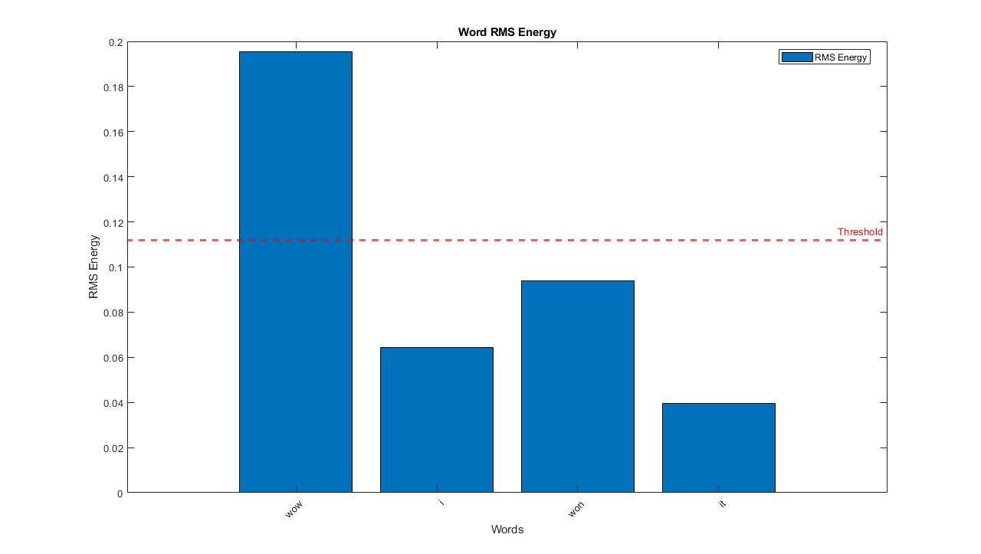
AUDIO-1

Slide 30
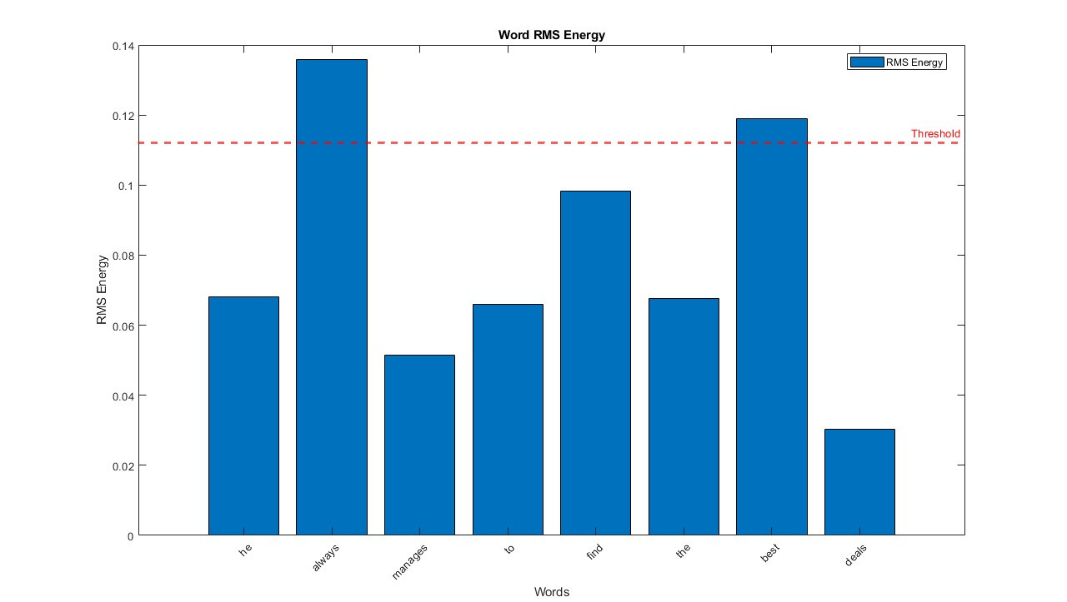
AUDIO-2

Slide 31
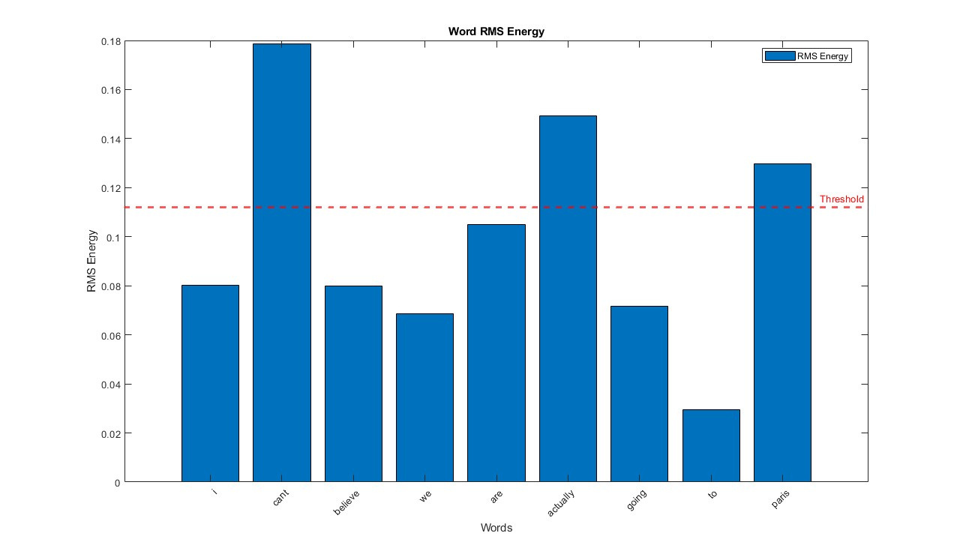
AUDIO-3

Slide 32
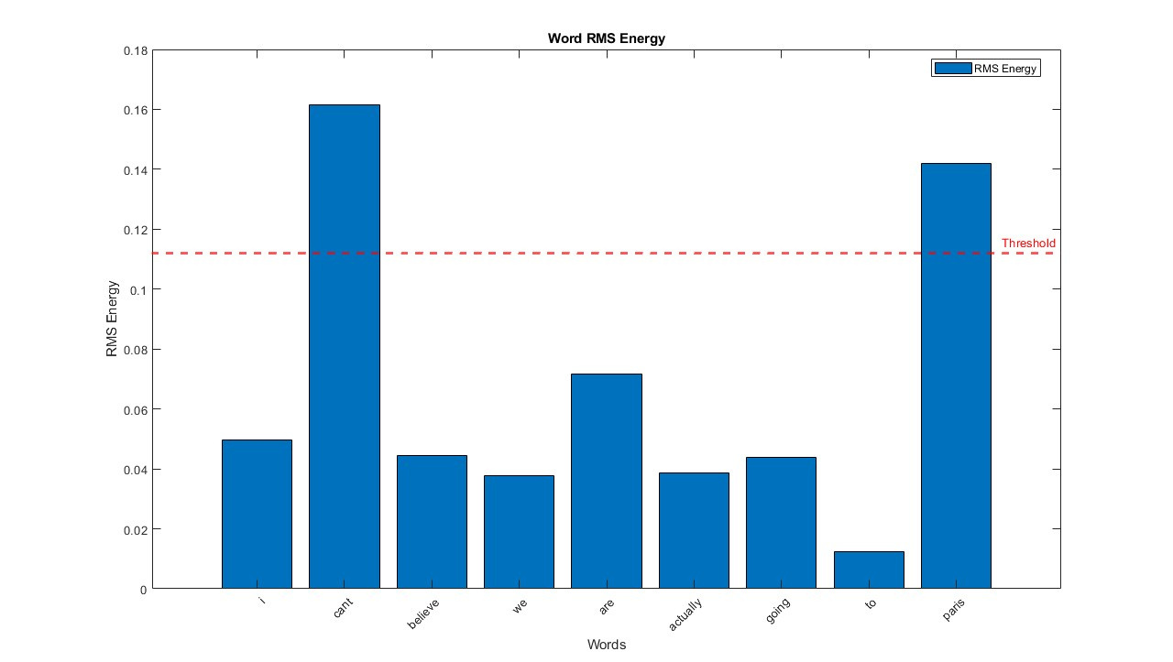
AUDIO-4

Slide 33
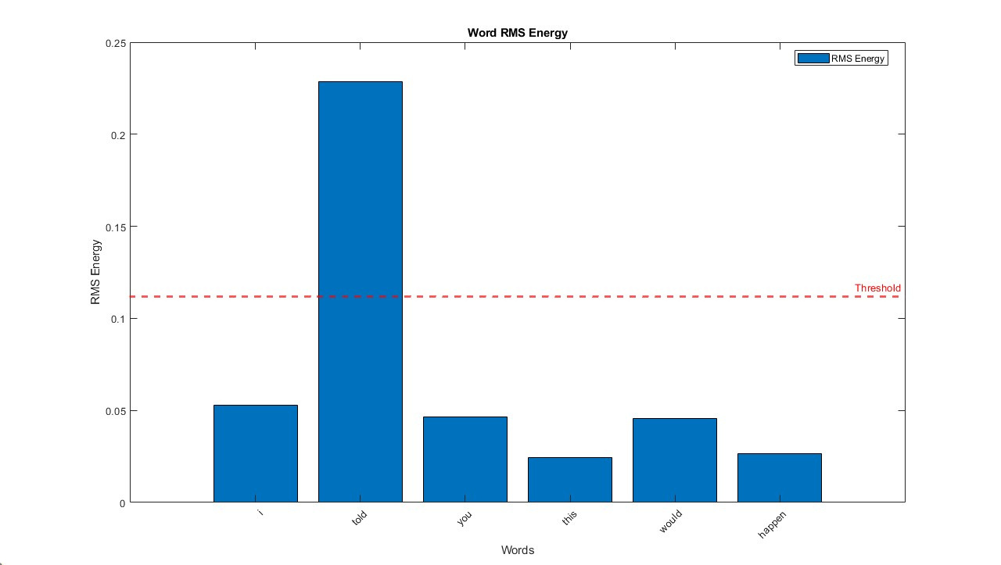
AUDIO-5

Slide 34
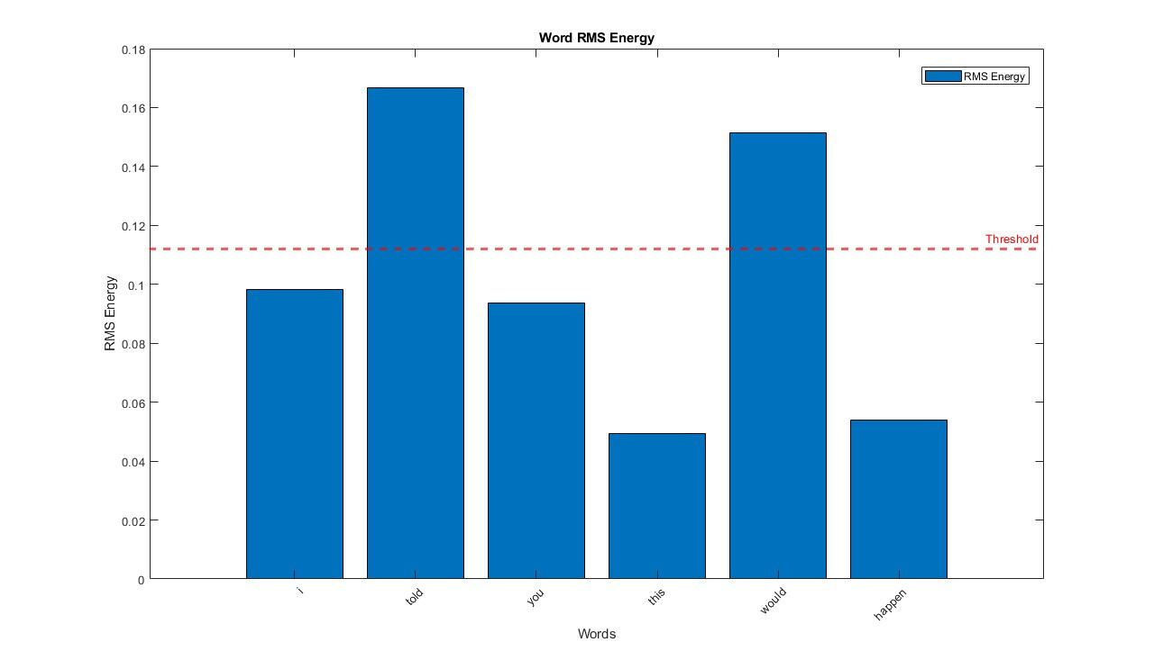
AUDIO-6

Slide 35
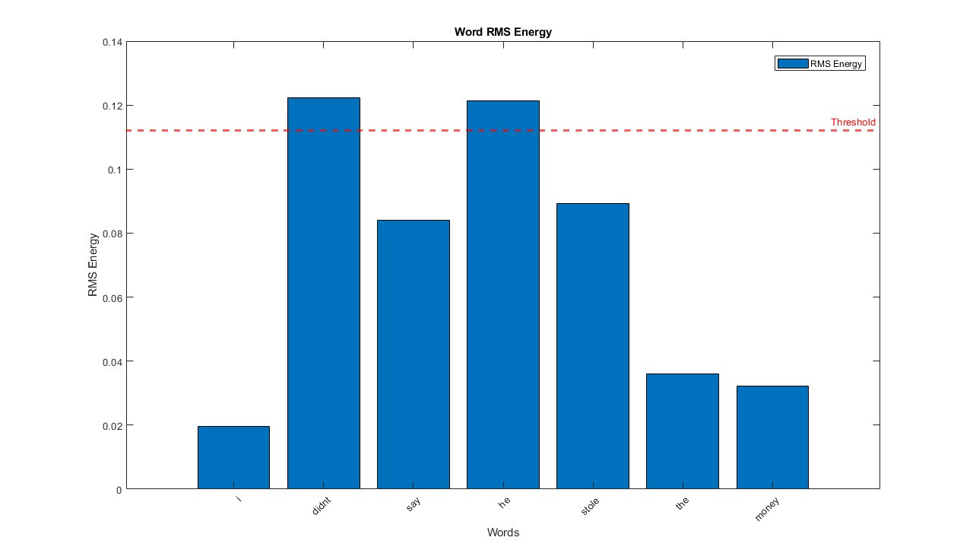
AUDIO-7

Slide 36
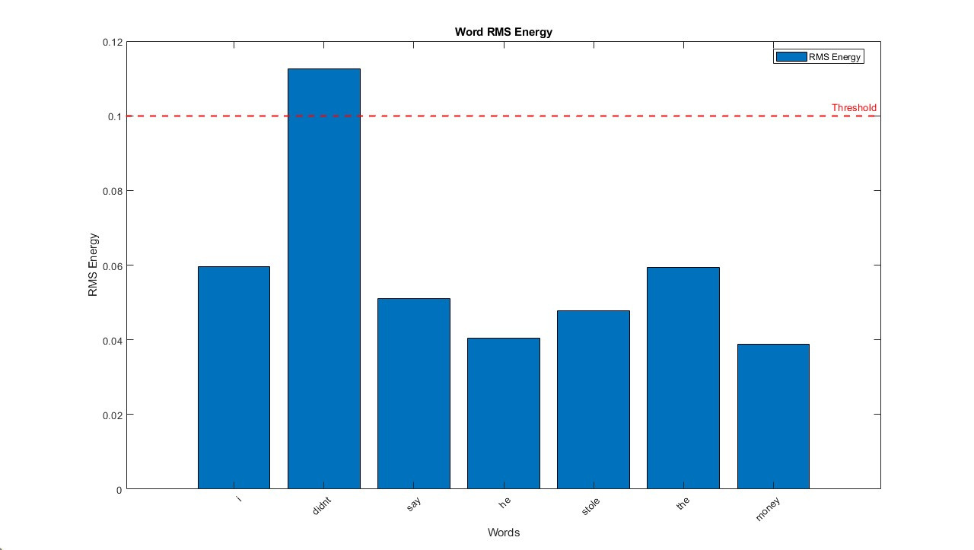
AUDIO-8

Slide 37
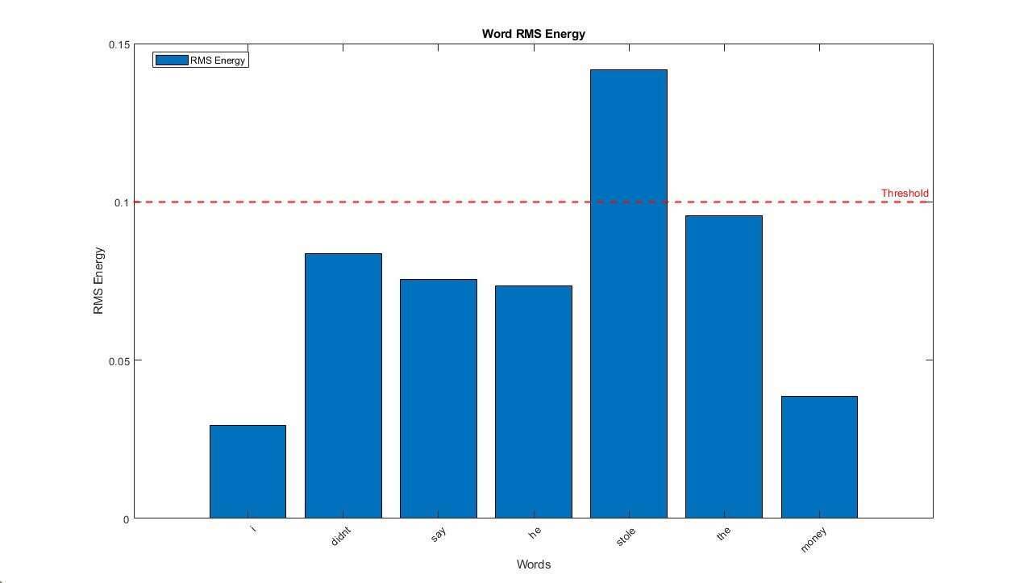
AUDIO-9

Slide 38
TASK-2
For task-2, we don’t have the time stamps. So we calculate the energy of the signal by taking small 25ms windows and then set a low threshold to distinguish between speech region and silence region. Then we separate these segments and calculate their rms energies and repeat the steps from task-1 again

Slide 39
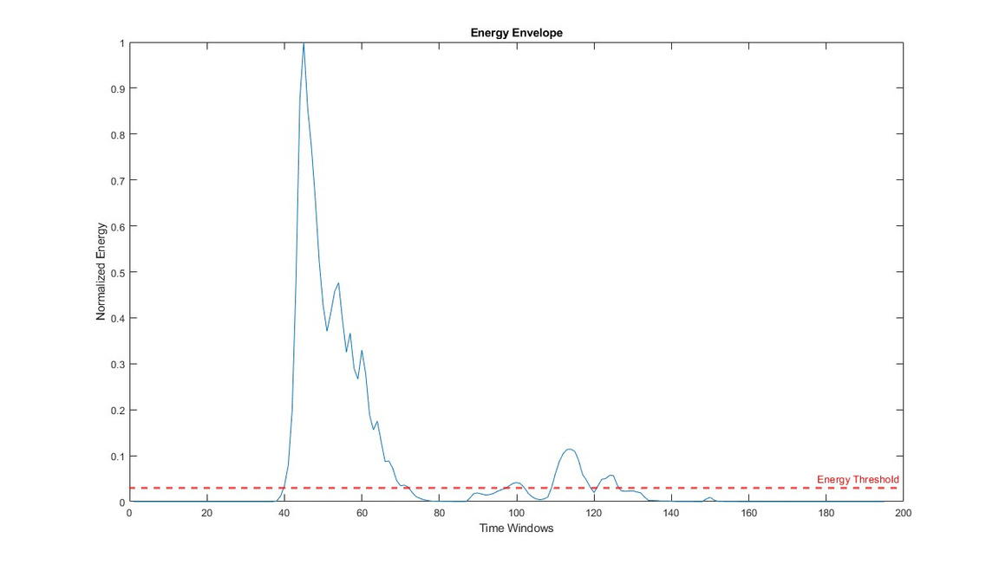
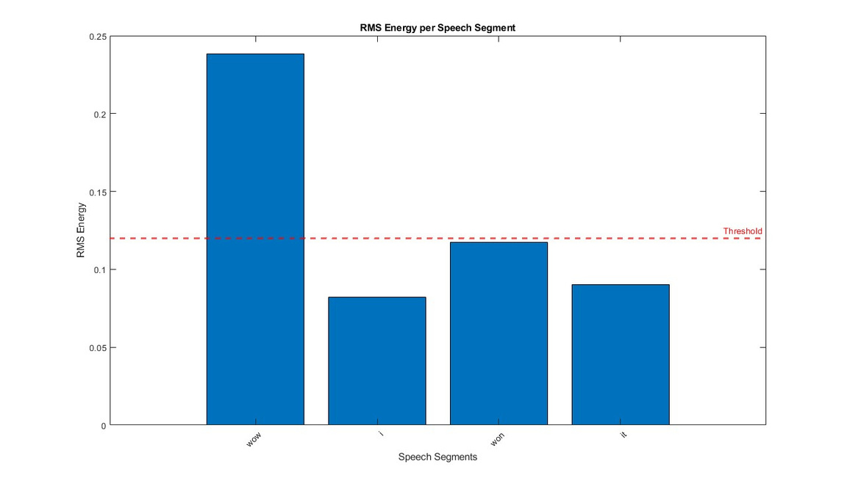
AUDIO-1

Slide 40
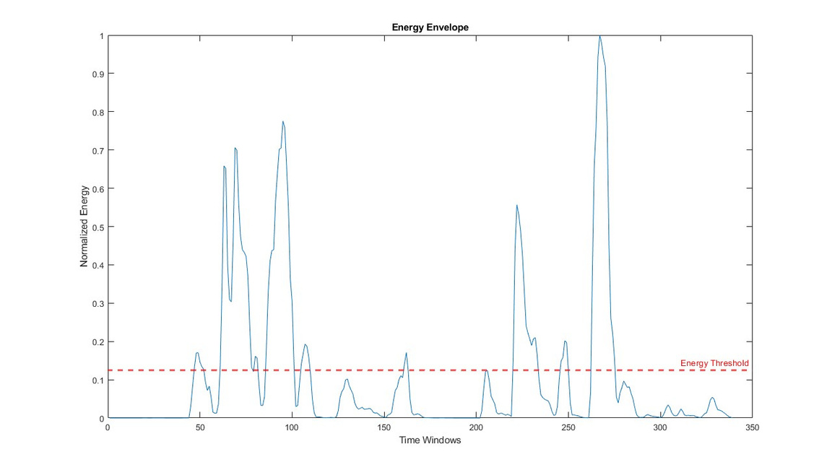
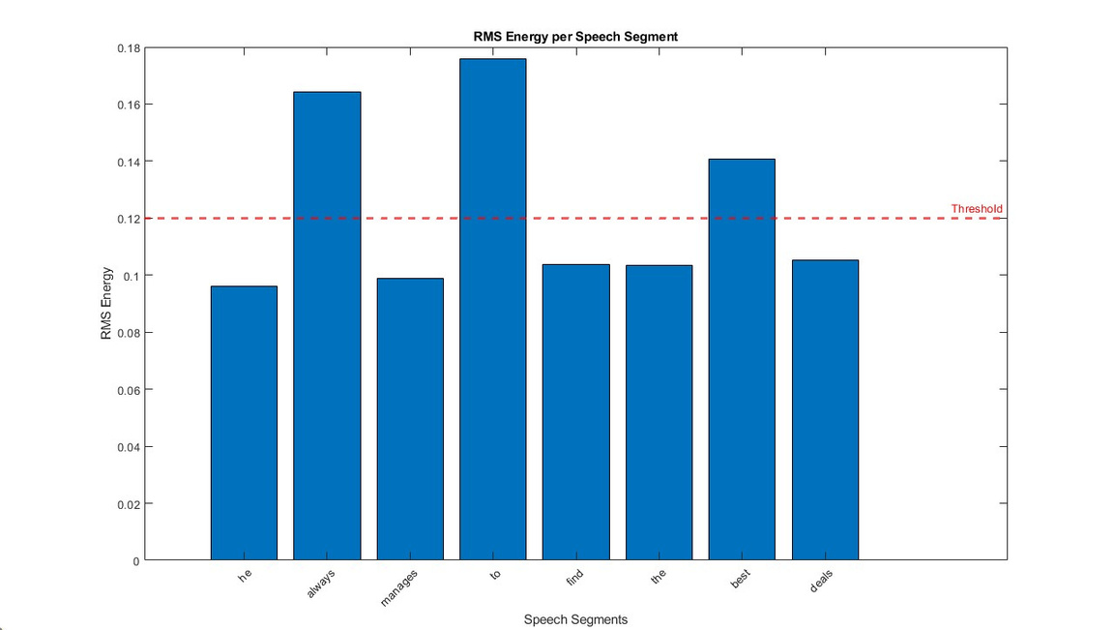
AUDIO-2

Slide 41
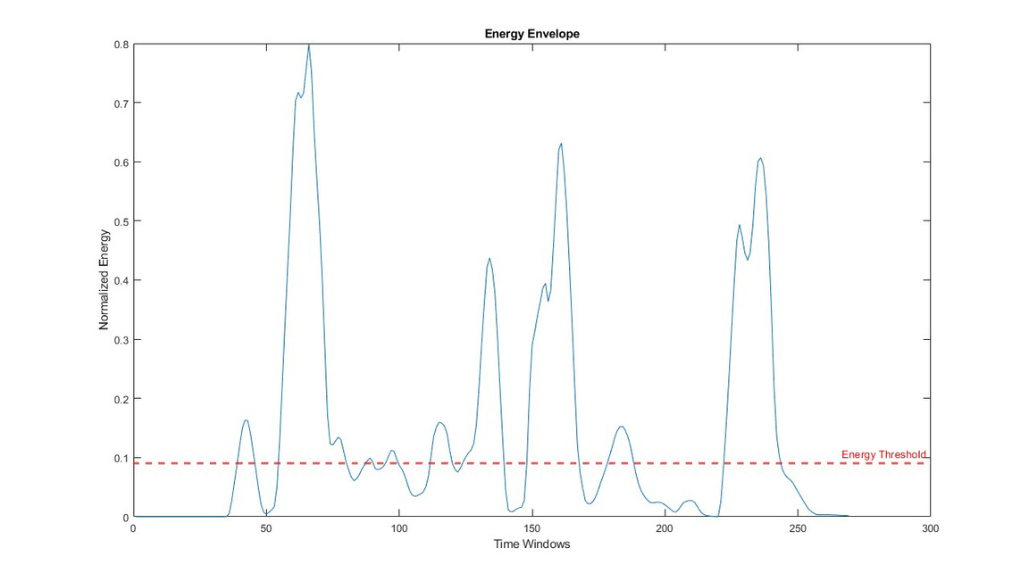
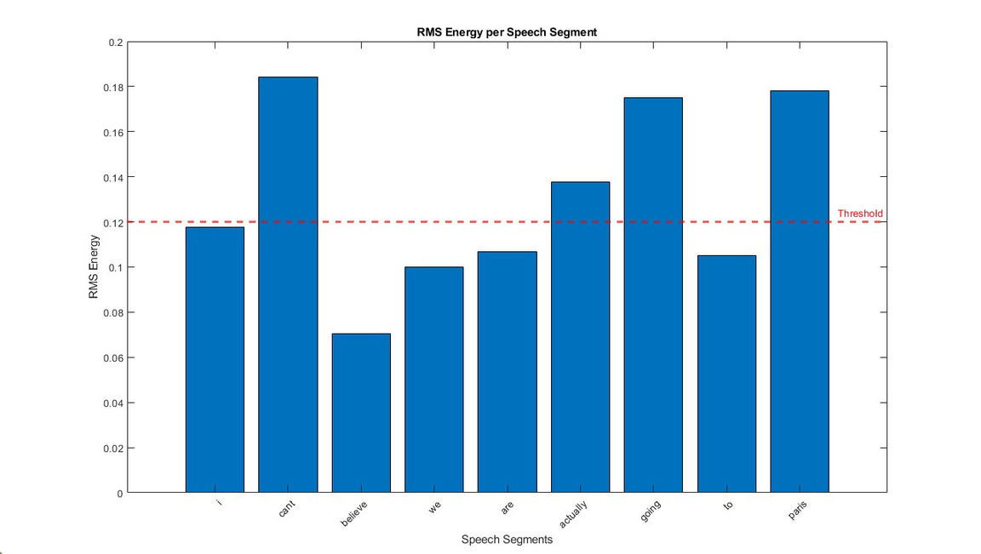
AUDIO-3

Slide 42
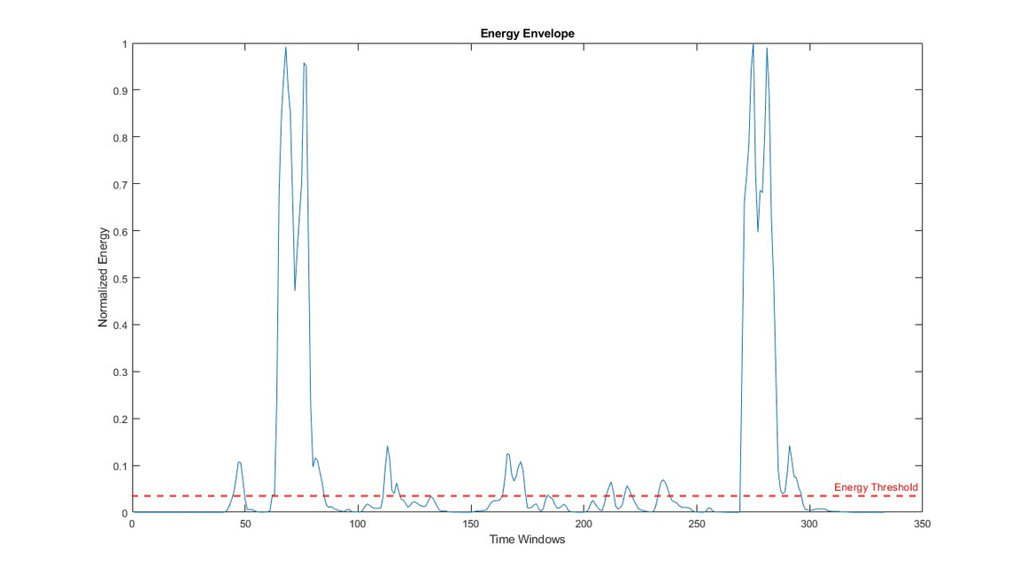
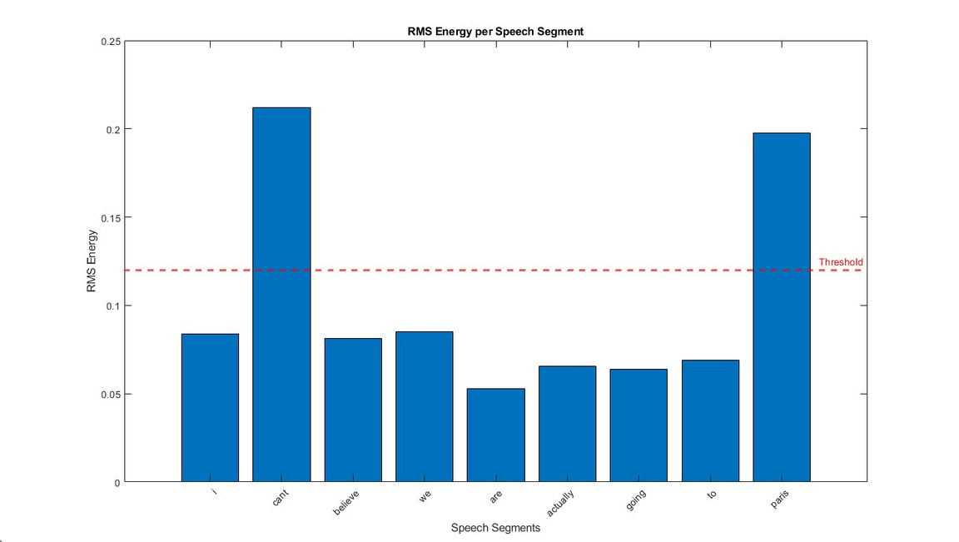
AUDIO-4

Slide 43
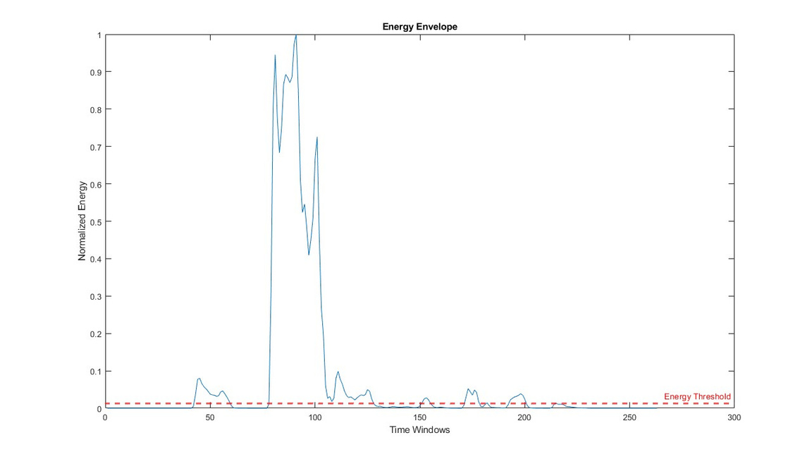
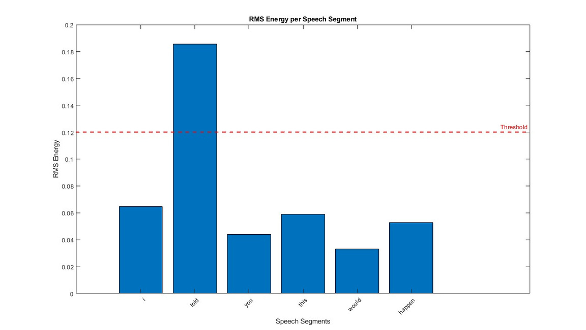
AUDIO-5

Slide 44
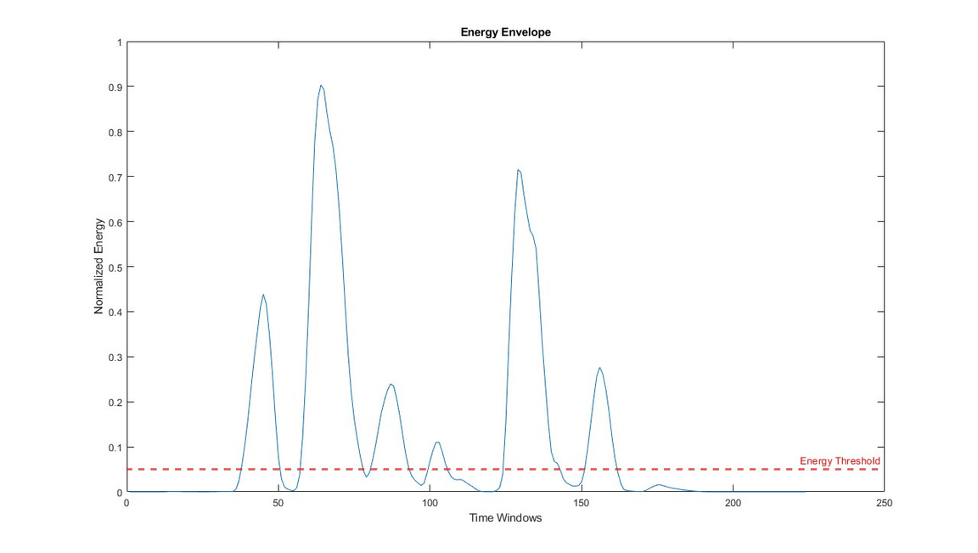
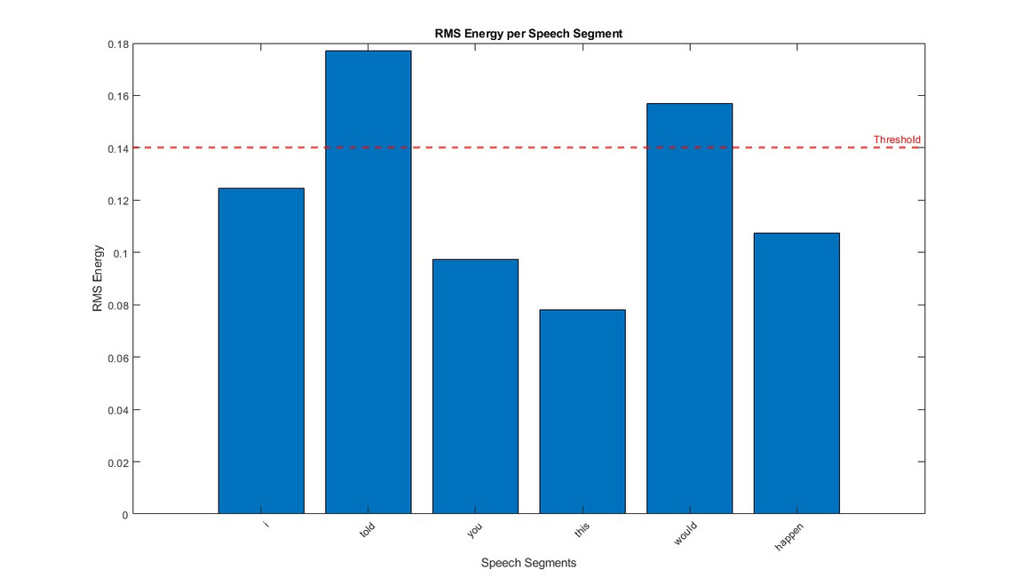
AUDIO-6

Slide 45
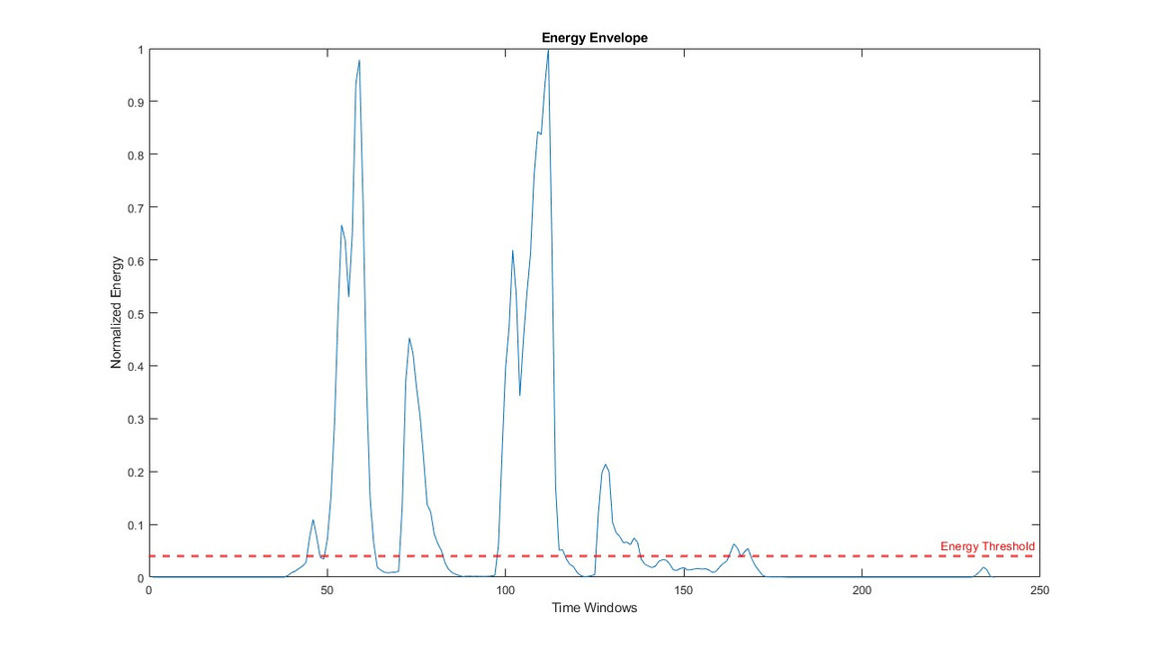
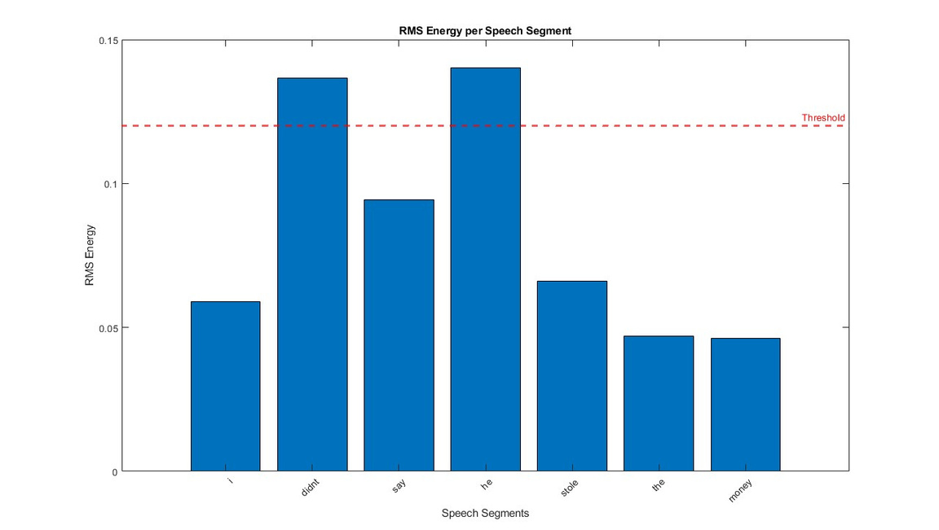
AUDIO-7

Slide 46
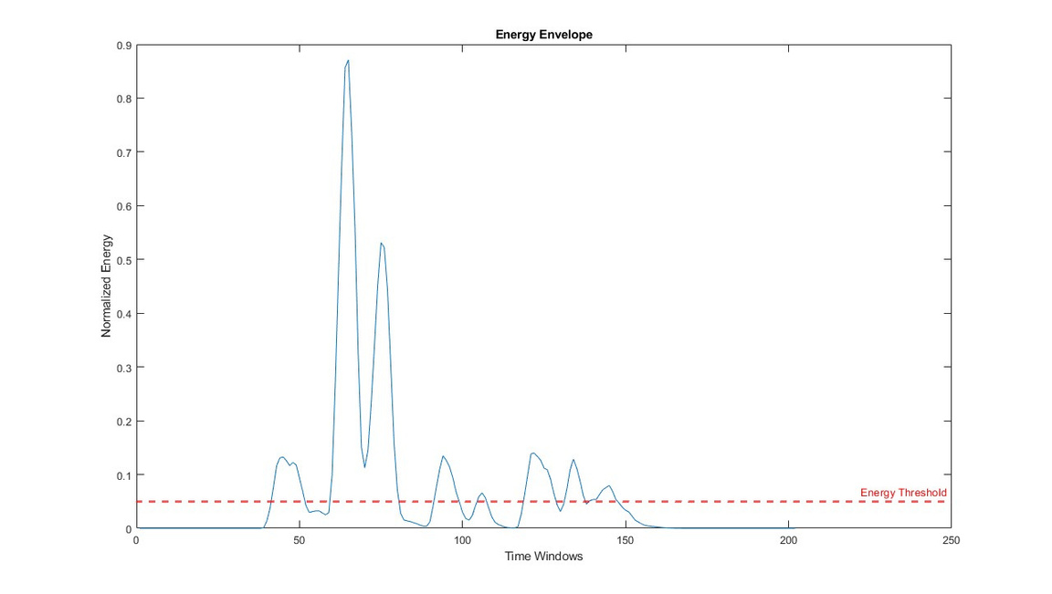
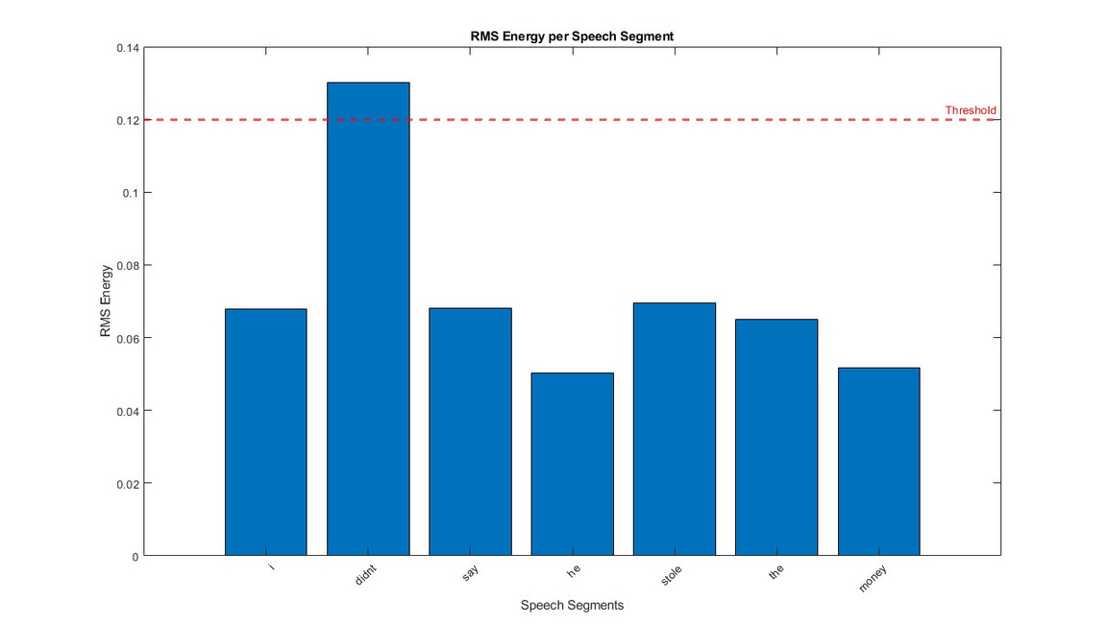
AUDIO-8

Slide 47
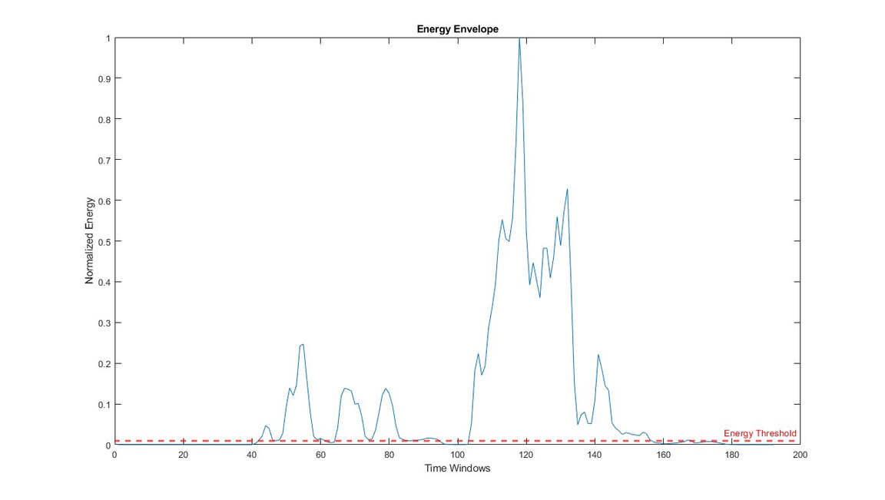
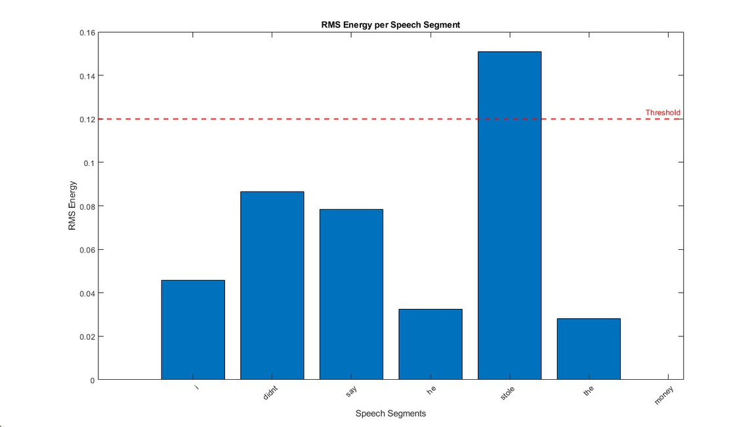
AUDIO-9

Slide 48
LIMITATIONS
1. Fixed Thresholds
  Problem: The method uses fixed thresholds for energy (energy_threshold) and loudness (rms_threshold), which are not adaptable to varying background noise levels or audio characteristics.
  Impact: This could lead to:
    False Positives: Background noise exceeding the energy threshold is detected as speech.
    False Negatives: Low-energy speech or words may not be detected.
2. Overlap Between Speech and Silence
  Problem: Energy-based methods struggle to handle overlapping regions where speech transitions into silence or vice versa.
  Impact: Results in inaccurate segmentation boundaries, leading to split or combined segments.
3. Lack of Spectral Information
  Problem: The method uses energy, which is a time-domain feature, and ignores spectral characteristics of the signal.
  Impact:
    Cannot distinguish between speech and similar energy non-speech sounds (e.g., music, claps, or noise).
    Sensitive to variations in speaker pitch or tonal differences.

Slide 49
THANK
YOU

